Slide 1
Lecture 1 Introduction to Algorithm

Slide 2
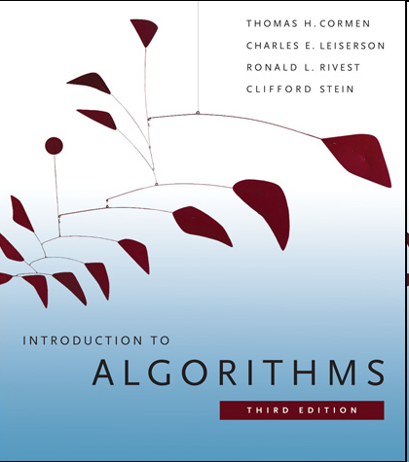
Textbook & Grade
Thomas Cormen, Charles Leiserson, Ronald Rivest, and Clifford Stein. Introduction to Algorithms. 3rd ed.
Grade system: written homework + final exam
QQ group: 1087382648
Reminder:
Rich resources online (e.g., lectures, projects, and assignments).
Python programming languages are recommended to implement algorithms.

Slide 3
Course Content
Introduction
Divide and conquer
Computation models
Sorting and trees
Dynamic programming
Greedy algorithms
NP-completeness

Slide 4
Definition of algorithms
A sequence of steps which is used to solve a category of problems.
Unambiguous: every step is deterministic
Mechanical: machine can “understand”
Finite: be implemented in limited steps
Input/output: state the problem size and the result

Slide 5
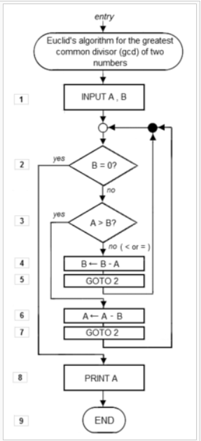
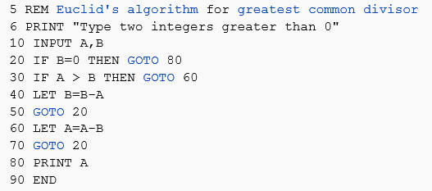
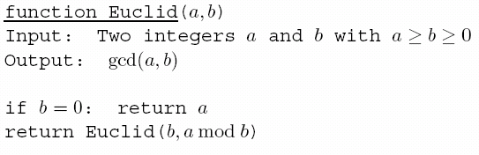
Algorithm representation
Program
√ Pseudocode
Flow chart

Slide 6
Algorithm vs. Program
Some people maybe think that algorithms are just programs. We need to clarify that programs could be a way to express algorithms, and they are not exactly same.
The big difference between algorithms and programs is that algorithms are for people to communicate while programs are for machines to run.
Generally, algorithms cannot be directly executed in computers. In additions, it is too precise when we use programs to express algorithms.

Slide 7
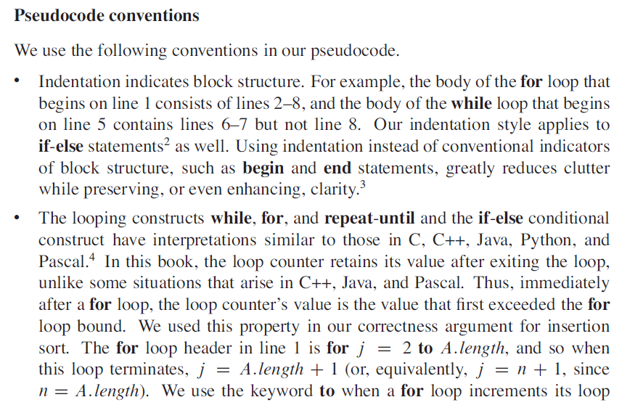

Slide 8
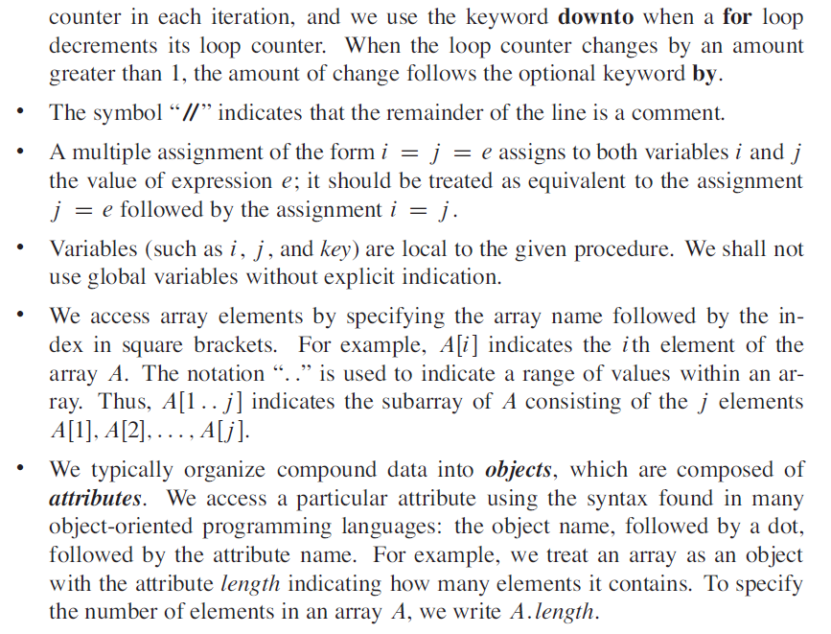
Notes:
comment[ˈkɑːment]
// backslash

Slide 9
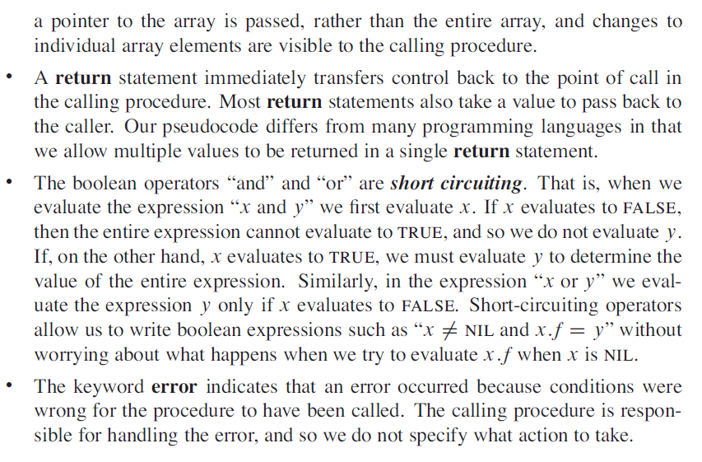

Slide 10
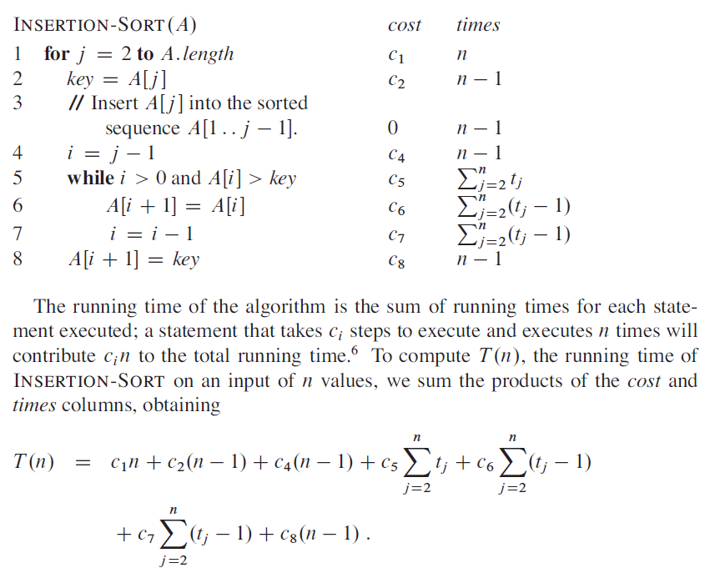
Example of T(n)
t_{j}: the number of comparisons in the while loop to insert the jth element
Ex: 4 2 8 3
j=2 key=2, t2=2
j=3 key=8, t3=1
j=4 key=3, t4=3
Notes:
(n+1)-2+1=n

Slide 11
Asymptotic notation
Why not express running time in terms of basic computer steps?
Too precise: you need to count the times carefully.
Depend on particular machines: the cost could be different.
Simplification: 5n³+4n+3 → 5n³ → n³
Leave out lower-order terms (insignificant as n grows)
Leave out the coefficient in the leading term (computers will be faster)
Finally, 5n³+4n+3 = O(n³)

Slide 12
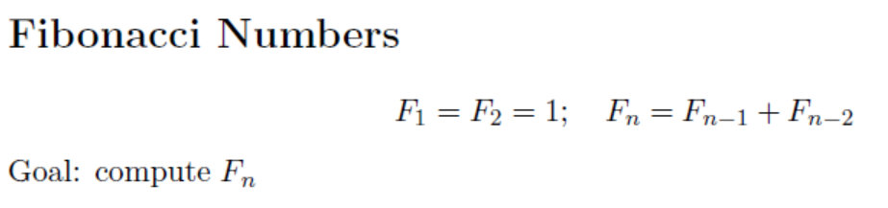
Why analysis?
Correctness
Is the algorithm correct?
Efficiency
Can we do better?
Example

Slide 13
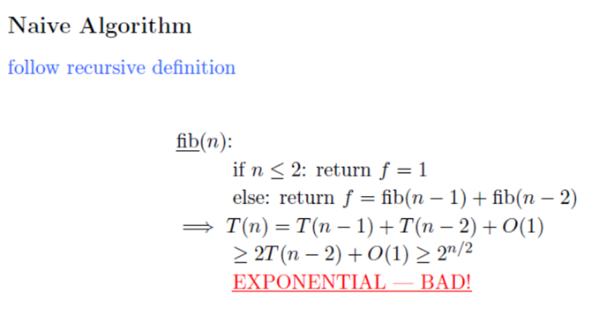

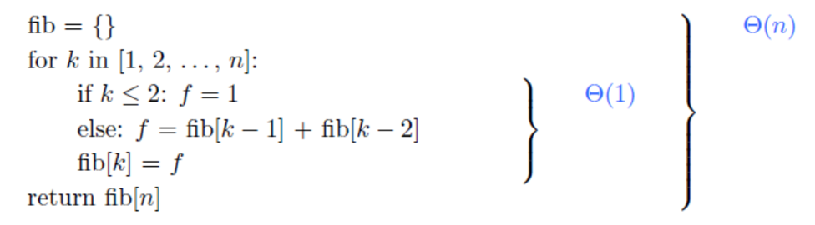

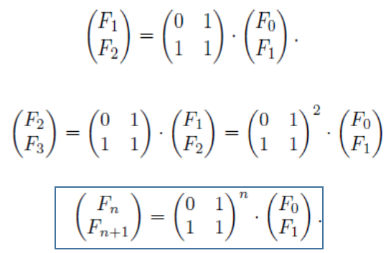

Slide 14


O notation
Definition:
n: size of problem
f =O(g) is a loose analog of “f ≤g”. It differs from the usual notion ≤ because of the constant c.
E.g., 2n+20 =O(n²), 2n+20 =O(n+1), n+1 =O(2n+20), but n² ≠O(2n+20)

Slide 15
2n+20 =O(n²): for n ≤ 5, n² is smaller; n > 5, n² is larger.
But, 2n+20 scales much better than n² as n grows. (i.e., 2n+20 grows no faster than n²)

Slide 16
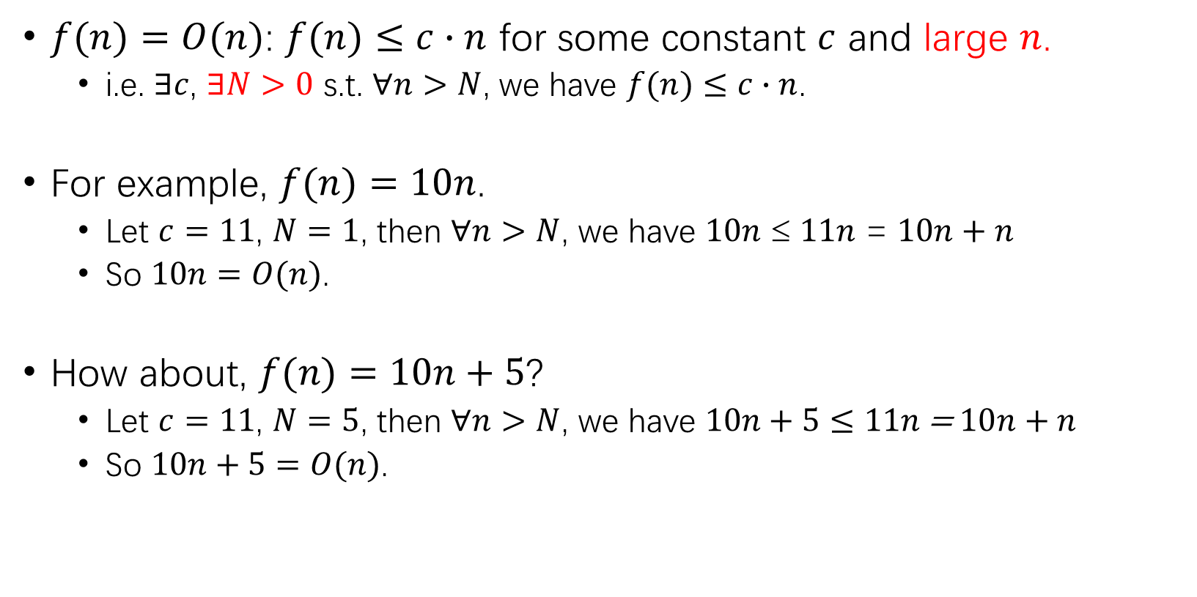
Extended definition: O
$f(n)=O(n)$: $f(n)≤c∙n$ for some constant $c$ and large $n$.
i.e. $∃c$, $∃N>0$ s.t. $∀n>N$, we have $f(n)≤c∙n$.
For example, $f(n)=10n$.
Let $c=11$, $N=1$, then $∀n>N$, we have $10n$ ≤ $11n$ = $10n+n$
So $10n=O(n)$.
How about, $f(n)=10n+5$?
Let $c=11$, $N=5$, then $∀n>N$, we have $10n+5≤11n\text{ = }10n+n$
So $10n+5=O(n)$.

Slide 17
Example: n^{1/2} vs. n
10n
9n
7n
n^{1/2}
0.1n
No matter how small c is, as long as it’s some positive constant, then finally cn will catch up n^{1/2}.
Thus, n^{1/2} = O(n)

Slide 18
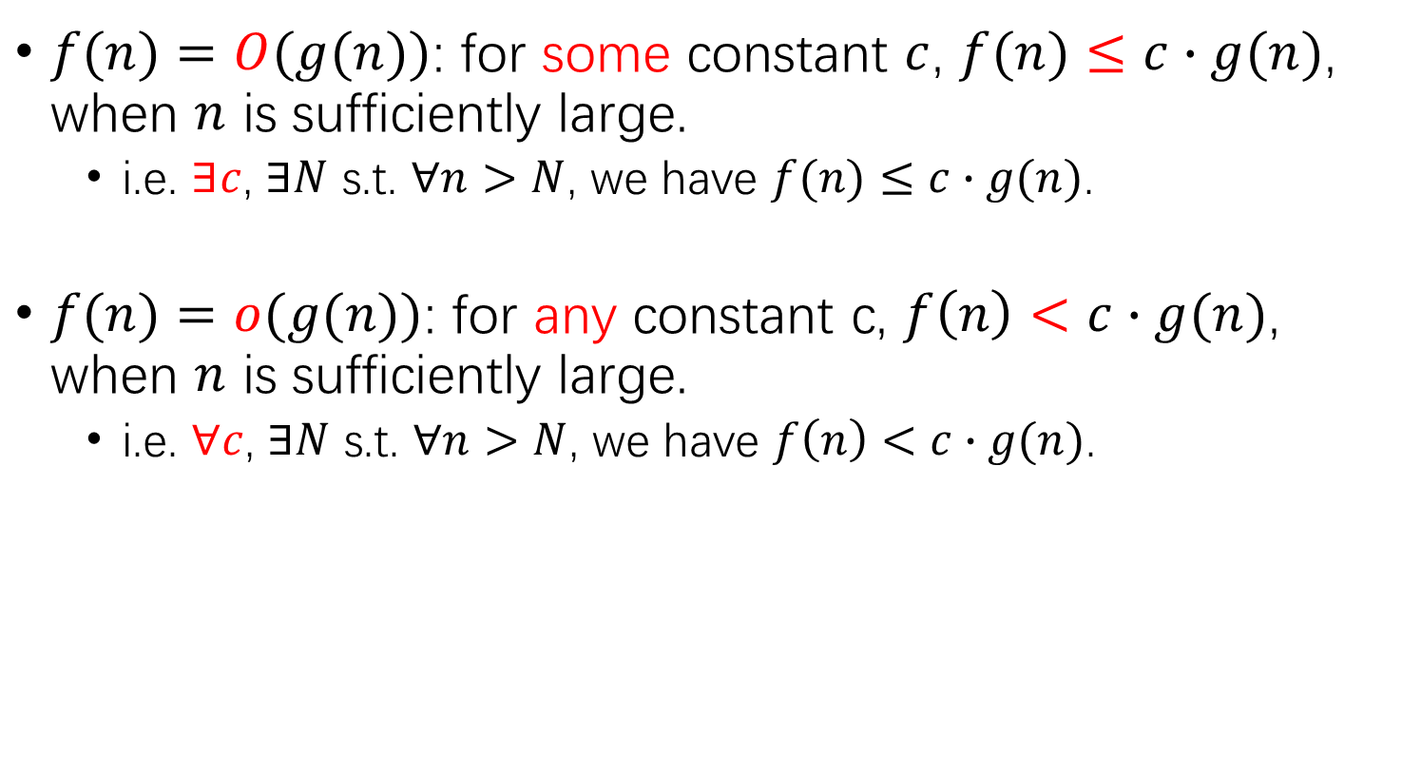
General definitions
$f(n)=O(g(n))$: for some constant $c$, $f(n)≤c∙g(n)$, when $n$ is sufficiently large.
i.e. $∃c$, $∃N$ s.t. $∀n>N$, we have $f(n)≤c∙g(n)$.
$f(n)=o(g(n))$: for any constant c, $f\left(n\right)<c∙g(n)$, when $n$ is sufficiently large.
i.e. $∀c$, $∃N$ s.t. $∀n>N$, we have $f\left(n\right)<c∙g(n)$.

Slide 19
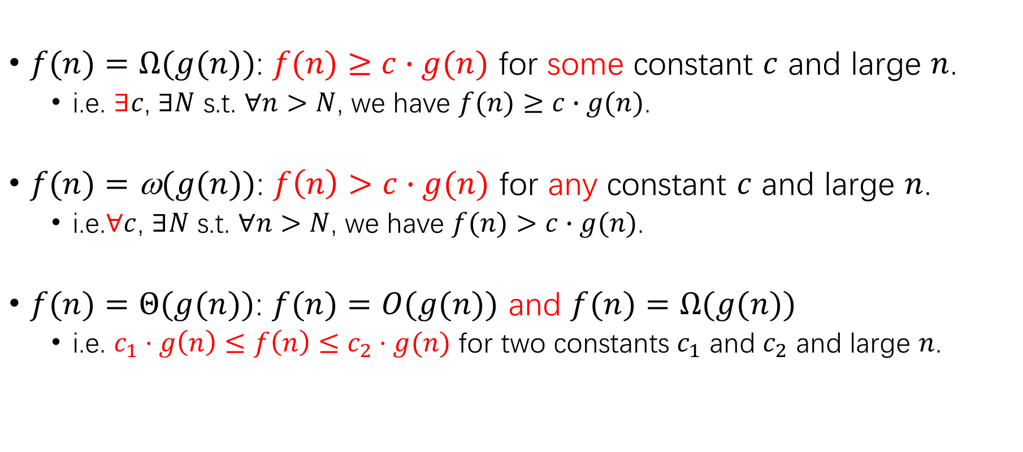
General definition (cont.)
$f(n)=Ω(g(n))$: $f(n)≥c∙g(n)$ for some constant $c$ and large $n$.
i.e. $∃c$, $∃N$ s.t. $∀n>N$, we have $f(n)≥c∙g(n)$.
$f(n)=\text{ω}(g(n))$: $f\left(n\right)>c∙g(n)$ for any constant $c$ and large $n$.
i.e.∀$c$, $∃N$ s.t. $∀n>N$, we have $f(n)>c∙g(n)$.
$f(n)=Θ(g(n))$: $f(n)=O(g(n))$ and $f(n)=Ω(g(n))$
i.e. $c_{1}⋅g\left(n\right)≤f\left(n\right)≤c_{2}⋅g(n)$ for two constants $c_{1}$ and $c_{2}$ and large $n$.

Slide 20
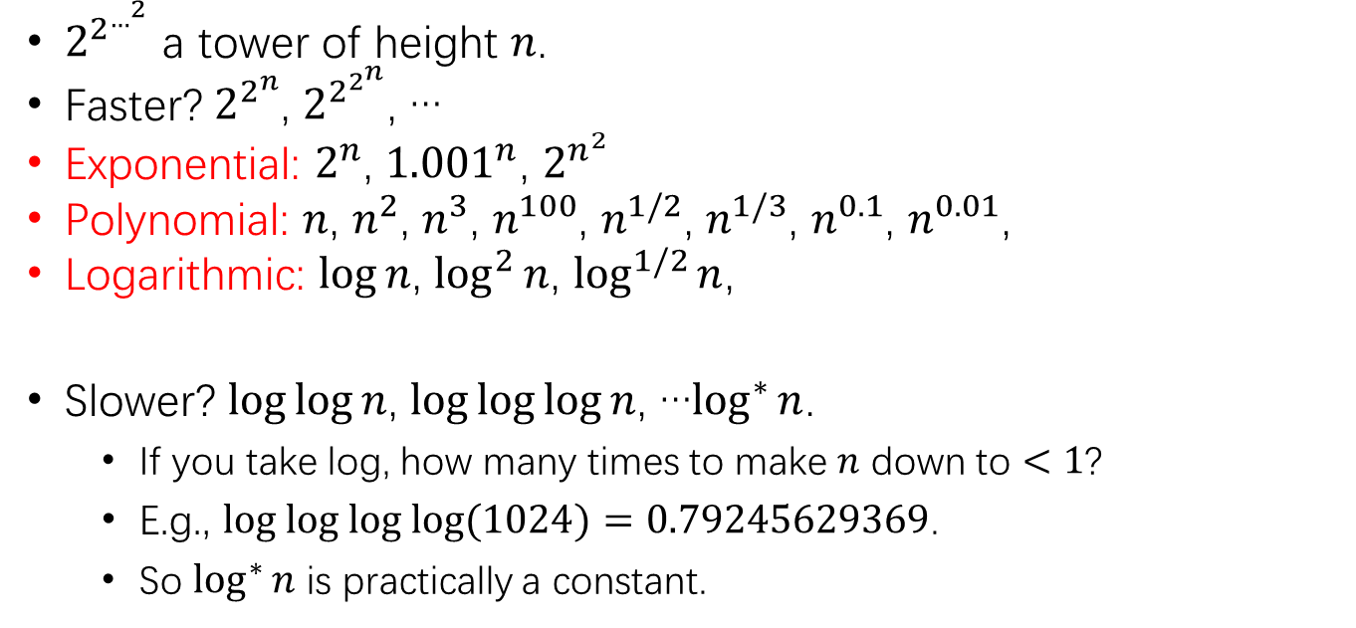

Spectrum of functions
|←exponential→|
tower
O(1) , …, log* n, … loglog n, … log n, log² n, …
… n^{1/3}, n^{1/2}, n, n², n³, … … 2^{n}, $2^{n^{2}}$, … $2^{2^{n}}$, … $2^{2^{…^{2}}}$
…
|← constant →|
|← logarithmic →|
|← polynomial →|
double exponential
$2^{2^{…^{2}}}$ a tower of height $n$.
Faster? $2^{2^{n}}$, $2^{2^{2^{n}}}$, …
Exponential: $2^{n}$, ${1.001}^{n}$, $2^{n^{2}}$
Polynomial: $n$, $n^{2}$, $n^{3}$, $n^{100}$, $n^{1/2}$, $n^{1/3}$, $n^{0.1}$, $n^{0.01}$,
Logarithmic: $\log{n}$, $\log^{2}{n}$, $\log^{1/2}{n}$,
Slower? $\log{\log{n}}$, $\log{\log{\log{n}}}$, …$\log^{∗}{n}$.
If you take log, how many times to make $n$ down to $<1$?
E.g., $log log log log{(1024)}=0.79245629369$.
So $\log^{∗}{n}$ is practically a constant.
Notes:
Log*: iterated logarithm

Slide 21
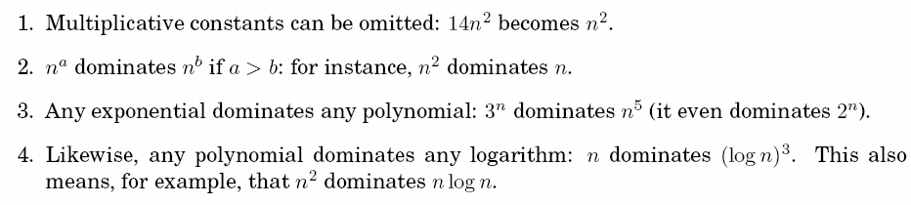
Commonsense rules

Slide 22
Properties of asymptotic notations
(1) Transitivity:
f(n)= Θ(g(n))， g(n)= Θ(h(n)) ⇒ f(n)= Θ(h(n))；
f(n)= O(g(n))， g(n)= O (h(n)) ⇒ f(n)= O(h(n))；
f(n)= Ω(g(n))， g(n)= Ω(h(n)) ⇒ f(n)= Ω(h(n))；
f(n)= o(g(n))， g(n)= o(h(n)) ⇒ f(n)= o(h(n))；
f(n)= ω(g(n))， g(n)= ω(h(n)) ⇒ f(n)= ω(h(n))；

Slide 23
(2) Reflexivity
f(n)= Θ(f(n))
f(n)= O(f(n))
f(n)= Ω(f(n))
(3) Symmetry
f(n)= Θ(g(n)) ⇔ g(n)= Θ (f(n))
(4) Mutual symmetry
f(n)= O(g(n)) ⇔ g(n)= Ω (f(n))
f(n)= o(g(n)) ⇔ g(n)= ω (f(n))
(5) Arithmetic operations：
O(f(n))+O(g(n)) = O(max{f(n),g(n)})
O(f(n))+O(g(n)) = O(f(n)+g(n))
O(f(n))*O(g(n)) = O(f(n)*g(n))
O(cf(n)) = O(f(n))
g(n)= O(f(n)) ⇒
O(f(n))+O(g(n)) = O(f(n))+O(O(f(n))) = O(f(n))
Notes:
Symmetry[ˈsɪmətri]
Mutual[ˈmjuːtʃuəl]

Slide 24
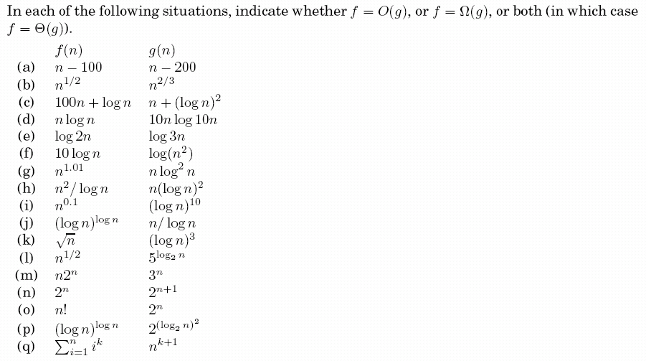
Exercise 0.1
solution ideas:
commonsense rules;
division/alignment;
definition.

Slide 26
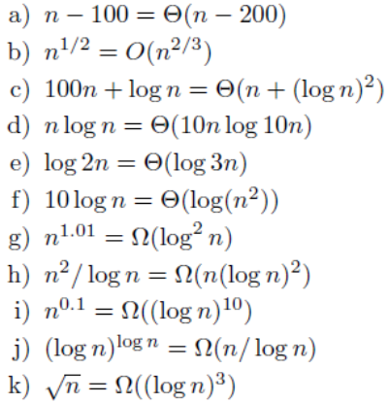
Notes:
logn*loglogn=logy=logn^loglogn, y=n^loglogn

Slide 27
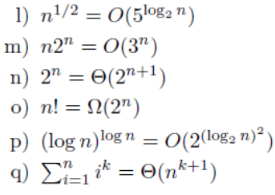

Slide 29

Notes:
1=(k+1,k+1)*j^0

Slide 30
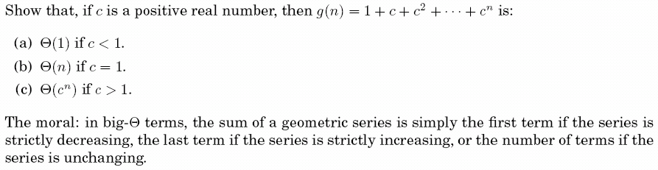
Exercise 0.2
Notes:
分子numerator
分母denominator

